Slide 1
Neurofeedback – My Story
Stuart Black
London Quantified Self
July 2013

Slide 2
Neurofeedback – My Story
Introduction
Neurofeedback & Quantified Self
How I found Neurofeedback
My Alpha Training Experience
Discovery of Neurofeedback Application
What is Neurofeedback ?
What I’m Doing With Neurofeedback Now
Questions
2

Slide 3

Introduction – Stuart Black
BSc Electronics & Computer Systems
Chartered Engineer
Led weapon system development for fast jets inc. Eurofighter
Change Management Consultant
Executive Director at Bupa Cromwell Hospital for 3 years
Interest in intersection of wellbeing & technology
Interest in personal development
Have a commercial interest in NF, but also a personal story to tell

Slide 4
Quantified Self & Neurofeedback
Monitoring (QS)
Feedback
Action
Neurofeedback integrates Monitoring (QS), Feedback & Action
Closes the loop in real time

Slide 5



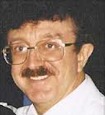

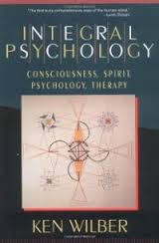
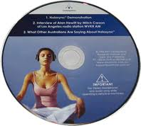

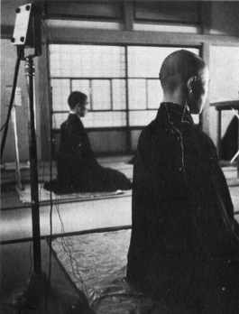
How I Found Neurofeedback (or How Neurofeedback Found me)
Sir John Whitmore Ken Wilber Bill Harris Jim Hardt
‘20 years worth of meditation in a week’
Holosync Binaural Beats Technology

Slide 6


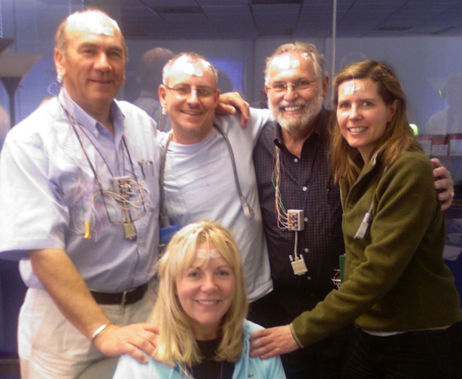
My ‘Alpha Training’ Experience
12 hours a day in centre
c. 5 hours Neurofeedback (no watches)
Lengthy de-brief & coaching afterwards
No nirvana, but much calmer & more focused
Went home, left job, got my ‘dream job’ as a consultant

Slide 7
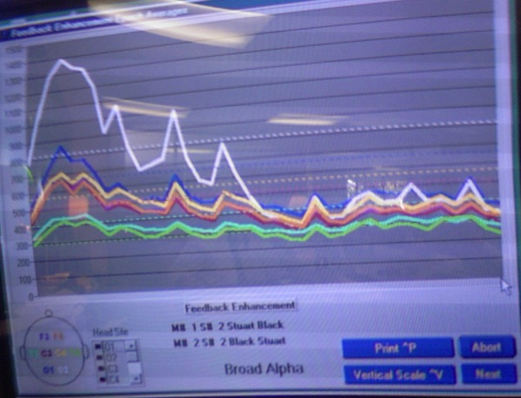
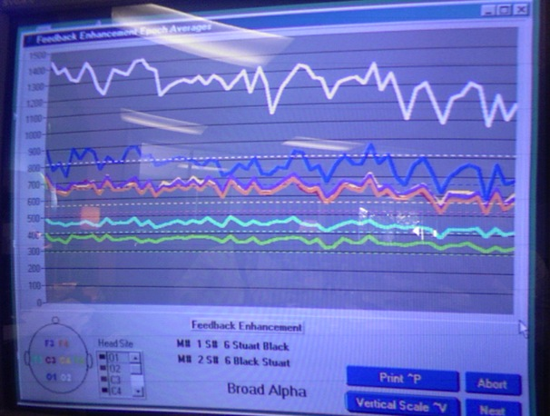
My ‘Alpha Training’ Experience
Before
After
‘Dream job’
Self-employed
Alpha training

Slide 8
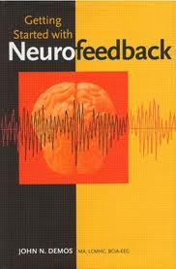
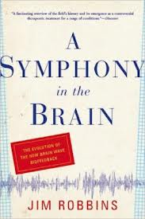
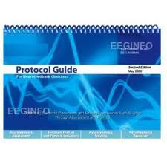
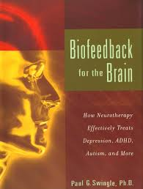
My Discovery of Neurofeedback Application
Majority of practitioners are using NF for therapeutic purposes
History goes back to 1950s
Therapeutic application discovered by accident – sleep research in cats
Wide range of application from migraine to stroke recovery to epilepsy & ‘Chemo Brain’
Body of evidence strong & growing

Slide 9
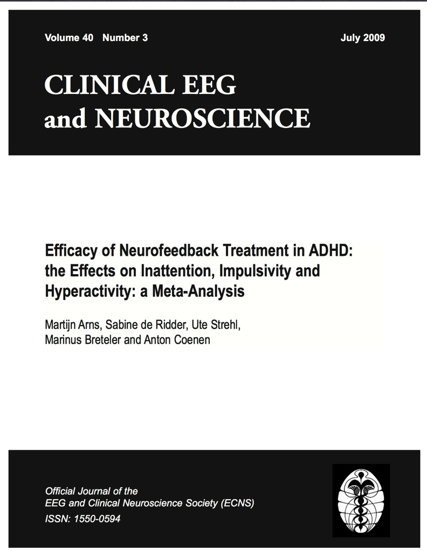
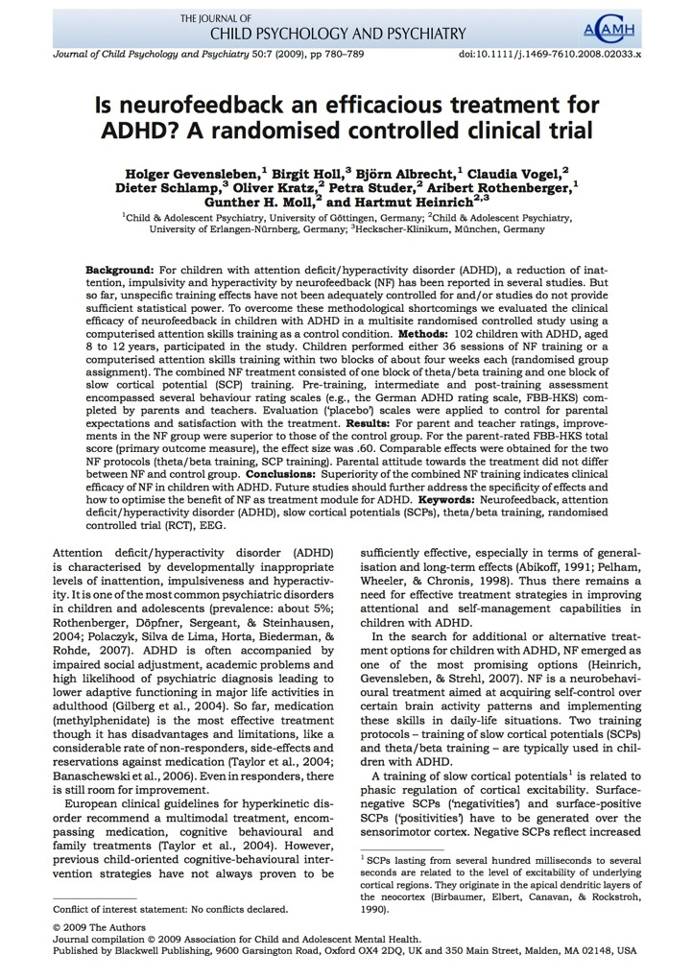
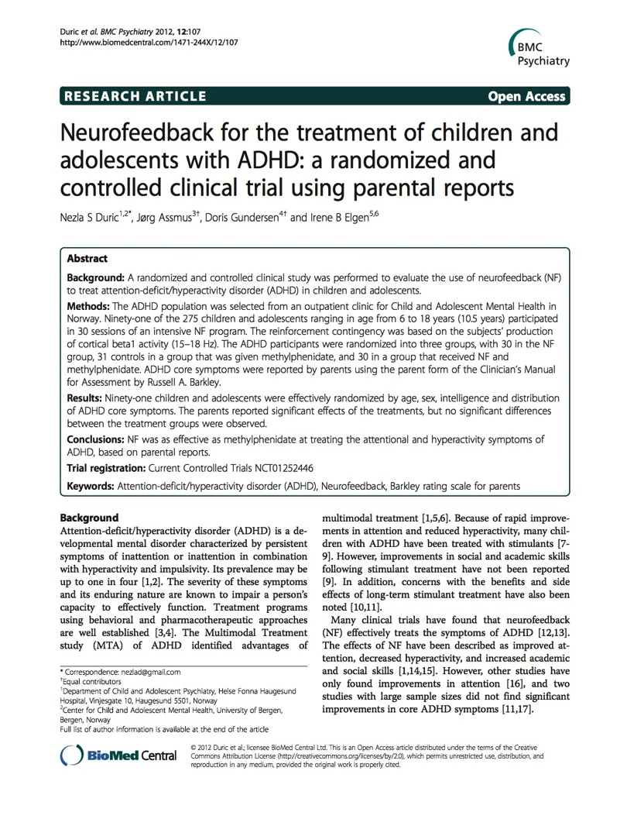
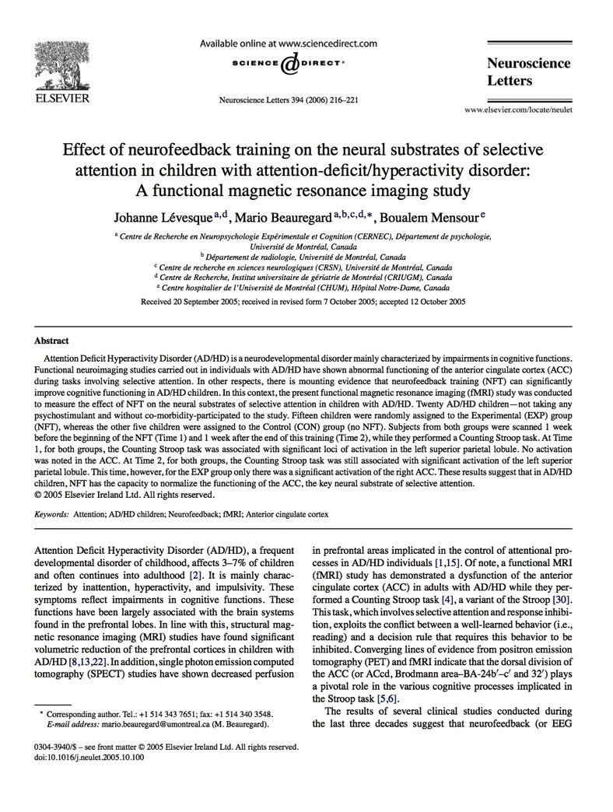
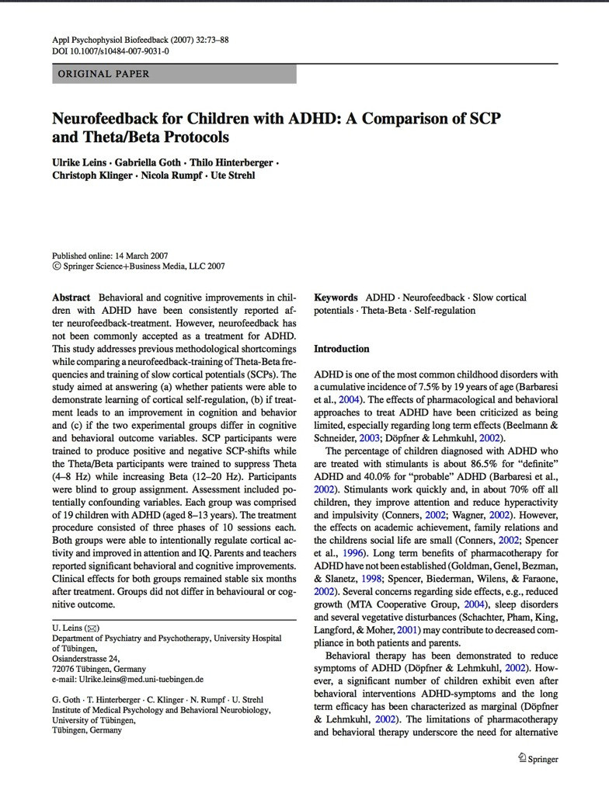
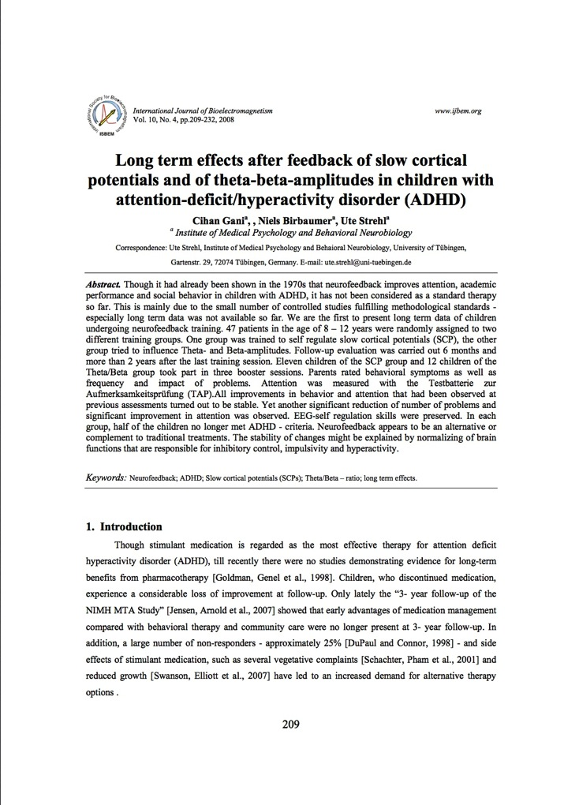
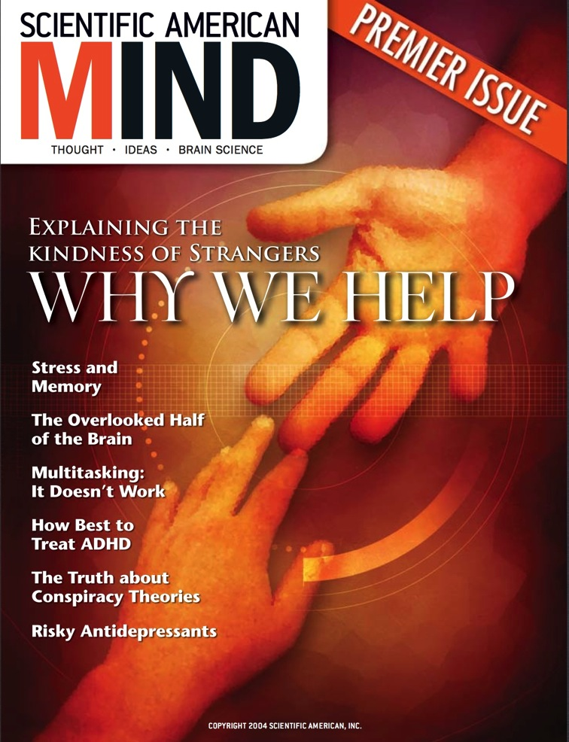
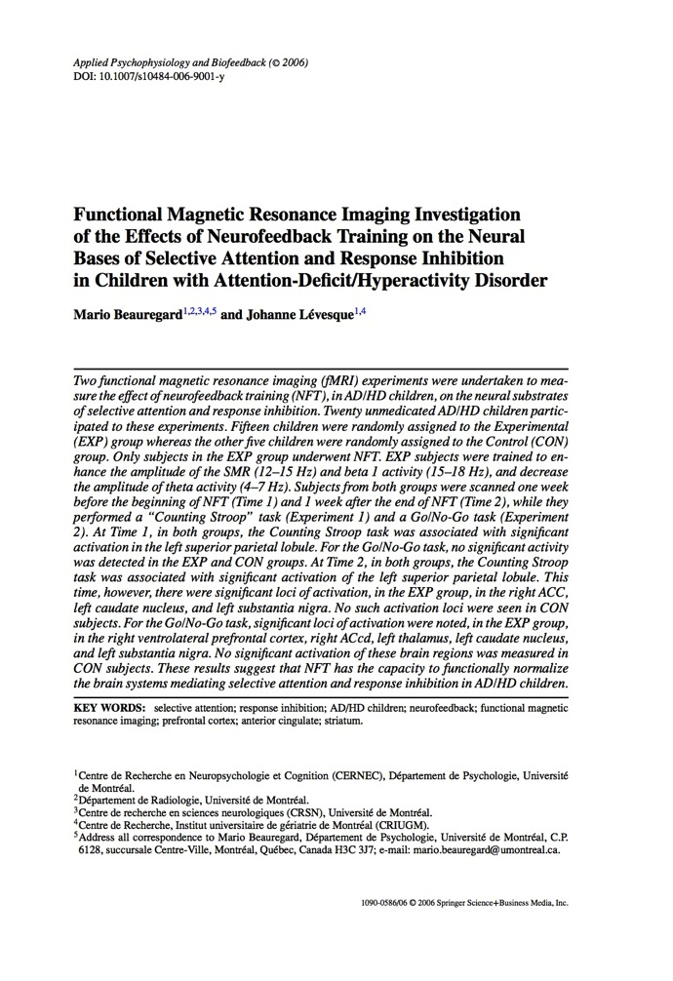
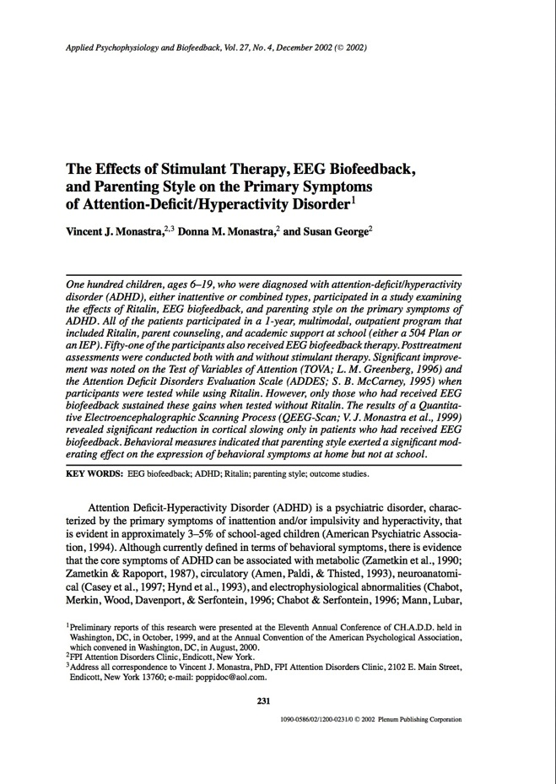
My Discovery of Neurofeedback Application
Majority of practitioners are using NF for therapeutic purposes
History goes back to 1950s
Therapeutic application discovered by accident – sleep research in cats
Wide range of application from migraine to stroke recovery to epilepsy & ‘Chemo Brain’
Body of evidence strong & growing

Slide 10

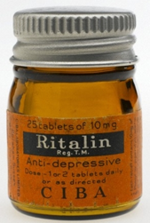
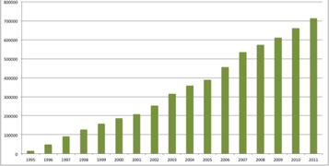
History of Neurofeedback
Milestones in Neurofeedback and ADHD Treatment
Neurofeedback is born. Joe Kamiya demonstrates control of Alpha waves in response to feedback.
Psychology Today article on Alpha feedback.
Othmers have been delivering NF training courses, equipment & clinical practice for 22 years
Barry Sterman suppreses epileptic seizures using Neurofeedback.
Othmers’ EEG Spectrum run first Neurofeedback training course
BrainTrainUK launched
Barry Sterman initial research on cat brain training published.
First application of Neurofeedback to Hyperactivity
American Academy of Pediatrics raises EEG-biofeedback level 1 Evidence-Based Psychosocial intervention for Attention & Hyperactivity
Science article describing Anxiety training
1950s
1960s
1970s
1980s
1990s
2000s
2010s
Ritalin marketed as adult anti-depressive.
ADHD ‘invented’ with publication of DSM-III-R.
US DEA highlights concerns at ‘quantity of stimulants that share virtually the same properties as cocaine’
Canadian authorities ban Cylert due to liver failures
UK ADHD Medication grows 15,000 to 714,000 prescriptions per annum
10

Slide 11
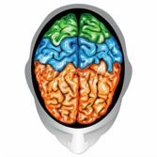
Neurofeedback Training
NF is a tool to improve central nervous system regulation
NF ‘Holds a mirror up to the brain’
Trains the brain’s ability to self-regulate by feeding back information on selected EEG rhythms related to regulation
Repeated sessions enable permanent learning – brain learns (or re-learns) to work better without the computer
The brain itself does the real work
Monitoring
Feedback
Action

Slide 12



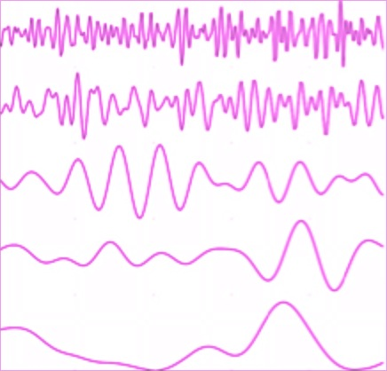
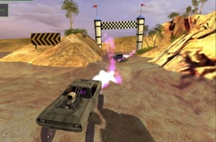



What is Neurofeedback ?
Feedback provided: ‘rewards’ when brain operates well, ‘inhibits’ when off-track
Practitioner
Frequency adjustment
Client symptoms & feedback
Sensor placement
sight
hearing
touch
Amplifier
Feedback
Video Games
or Videos
Client
Neurofeedback trains the brain’s ability to self-regulate by feeding back information on selected EEG rhythms related to regulation
12

Slide 13
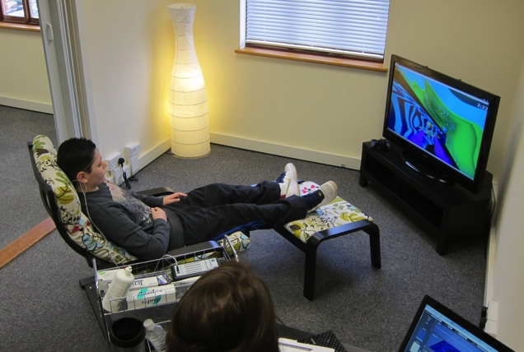
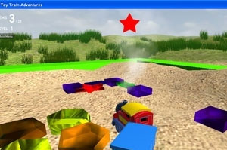
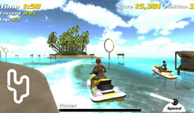
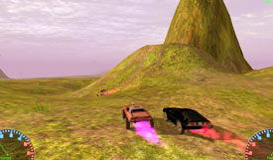
What is Neurofeedback ?
13

Slide 14


What I’m doing with NF now
Therapeutic Neurofeedback:
ADHD
Autistic Spectrum
Epilepsy
Dyslexia, Dyspraxia, Dysgraphia
Sleep problems
Stroke recovery
Trauma recovery
‘Chemo Brain’
Fibromyalgia
Migraine
Depression, Anxiety
OCD
Vertigo, Tinnitus
PTSD, Addiction
Peak Performance:
Limitations of performance
Emotional instability
Burn out
Lack of focus
Physical calming
Business performance
Leadership development
Personal development
Sports performance
Egham, Surrey | London - Clapham Junction, Fitzrovia | Hoddesdon, Herts

Slide 15
Thankyou for listening Questions ?
stuart@braintrainuk.com
BrainTrainUK.com
07796 266 377
@braintrainuk

Slide 16
References
Our website: braintrainuk.com
The approach we take: eeginfo.com
Leadership Development Framework:
http://www.harthill.co.uk/leadership-development-framework/leadership-development-framework.html
Jim Hardt’s facility (now in Vancouver): biocybernaut.com
Book on the history of NF:
http://www.amazon.co.uk/Symphony-Brain-Evolution-Wave-Biofeedback/dp/0802143814
16

Slide 17
Backup Slides
17

Slide 18
Our NF Training Approach
GP referral
Self referral
Specialist/school
referral
Free initial consultation
Letter
Assessment
Interview/report
Functional assessment (QIKtest)
Symptom selection
Letter
Training plan
Brain Training session (45 mins)
x 20
Symptom tracking
QIK-TEST assessment
Report
Report
Outcome evaluation
18

Slide 19
American Academy of Pediatrics – Oct 2012
Strength of Evidence Definitions
^{Level 1: Best Support}
I. At least 2 randomized trials demonstrating efficacy in one or more of the following ways:
a. Superior to pill placebo, psychological placebo, or another treatment.
b. Equivalent to all other groups representing at least one Level 1 or Level 2
treatment in a study with adequate statistical power (30 participants per group on average) and that showed significant pre‐post change in the index group as well as the group(s) being tied. Ties of treatments that have previously qualified only through ties are ineligible.
II. Experiments must be conducted with treatment manuals.
III. Effects must have been demonstrated by at least 2 different investigator teams.
19

Slide 20
Recent Evidence Base for NF for ADHD
Year | Journal | Sample | Control | Random | Key Results/Conclusions
2009 | *Journal of Child Psychology and Psychiatry | 102 | ✓ | ✓ | Results indicate clinical efficacy of NF for children with ADHD.
2006 | *Neuroscience Letters | 20 | ✓ | ✓ | Results suggest NF has the capacity to functionally normalize brain systems mediating selective attention and response inhibition in ADHD children.
2006 | *Applied Psychophysiology and Biofeedback | 20 | ✓ | ✓
2009 | Clinical EEG and Neuroscience | 1,194 | N/A | N/A | Meta study concluded NF is efficacious & specific for ADHD.
2012 | BMC Psychiatry | 130 | ✓ | ✓ | NF is as effective as methylphenidate.
2002 | Applied Psychophysiology and Biofeedback | 100 | ✓ |  | NF showed significant improvement in behavior, Ritalin did not. NF group showed normalisation of EEG, Ritalin group did not.
2005 | Child and Adolescent Psychiaric Clinics of North America | 100 | ✓ |  | NF group still showed improvement 2 years after end of NF, Ritalin effect ended on cessation of medication. 80% of NF group reduced Ritalin by > 50%; 85% of Ritalin group increased dose, 0 reduced.
2007 | Applied Psychophysiology and Biofeedback | 38 | ✓ | ✓ | 2 different NF protocols showed improvement in all 4 measures.
2008 | International Journal of Bioelectromagnetism | 38 | ✓ | ✓ | Improvements still present from NF 2 years after original trial.
* Studies that directly led American Academy of Pediatrics to endorse NF as Level 1 evidence-based psychosocial intervention October 2012

Slide 21
Recent Evidence Base for NF
The Journal of Child Psychology and Psychiatry - 2009
Gevensleben, H., Holl, B., Albrecht, B., Vogel, C., Schlamp, D., et al. (2009). Is neurofeedback an efficacious treatment for ADHD?: A randomized controlled clinical trial. Journal of Child Psychology and Psychiatry, 50, 780–789
Sample | 102 children aged 8-12 with ADHD diagnosis.
Control | Attention control software training game.
Outcome measurement | Pre & post training assessments using parent & teacher behaviour rating scales.
Results | Improvements with NF group > control group.
Conclusions | “Neurofeedback effects are substantial and of practical importance”. “indicates clinical efficacy of neuorofeedback in children with ADHD”.

Slide 22
Recent Evidence Base for NF
Neuroscience Letters - 2006
Levesque, J., Beauregard, M., & Mensour, B. (2006). Effect of neurofeedback training on the neural substrates of selective attention in children with attention deficit/hyperactivity disorder: A functional magnetic resonance imaging study. Neuroscience Letters, 394, 216–221.
Sample | 20 children with ADHD diagnosis.
Control | Control group had no NF training.
Outcome measurement | Pre & post training assessments of Counting Stroop test whilst brain activity was monitored using Functional MRI scan.
Results | Before training both groups showed abnormal brain function during test - no activity in anterior cingulate cortex (ACC). After training NF group showed significantly greater test score & significant activity in ACC.
Conclusions | Results “suggest that in ADHD children, neurofeedback therapy has the capacity to normalize the functioning of the ACC, the key neural substrate of selective attention”.

Slide 23
Recent Evidence Base for NF
Applied Psychophysiology and Biofeedback - 2006
Beauregard, M., & Levesque, J. (2006). Functional magnetic resonance imaging investigation of the effects of neurofeedback training on neural bases of selective attention and response inhibition in children with attention-deficit/hyperactivity disorder. Applied Psychophysiology and Biofeedback, 31, 3–20
Sample | 20 children with ADHD diagnosis.
Control | Control group had no NF training.
Outcome measurement | Pre & post training assessments of reaction and impulsivity test whilst brain activity was monitored using Functional MRI scan.
Results | Before training neither group showed activity in areas of brain associated with response inhibition. After training NF group showed significant test result improvements and fMRI showed significant activity in areas of the brain monitored.
Conclusions | Results “suggest that neurofeedback therapy has the capacity to functionally normalize the brain systems mediating selective attention and response inhibition in ADHD children”.

Slide 24
Recent Evidence Base for NF
Clinical EEG and Neuroscience - 2009
Arns, M., de Ridder, S., Strehl, U., Breteler, M., & Coenen, A. (2009). Efficacy of neurofeedback treatment in ADHD: the effects on inattention, impulsivity and hyperactivity: a meta-analysis. Clinical EEG and neuroscience, 40(3), 180-189.
Sample | Meta study of 15 previous studies of application of NF to ADHD with aggregated participants of 1,194.
Control | N/A.
Outcome measurement | The studies were analysed to assess to what extent it can be concluded that neurofeedback is an effective treatment for ADHD symptoms.
Results | The authors concluded “the clinical effects of neurofeedback in the treatment of ADHD can be regarded as clinically meaningful.”
Conclusions | “We conclude that neurofeedback treatment for ADHD can be considered ‘Efficacious and Specific’ (level 5) with a high ES for inattention and impulsivity and a medium ES for hyperactivity.”

Slide 25
Recent Evidence Base for NF
Clinical EEG and Neuroscience - 2009
Arns, M., de Ridder, S., Strehl, U., Breteler, M., & Coenen, A. (2009). Efficacy of neurofeedback treatment in ADHD: the effects on inattention, impulsivity and hyperactivity: a meta-analysis. Clinical EEG and neuroscience, 40(3), 180-189.
Sample | Meta study of 15 previous studies of application of NF to ADHD with aggregated participants of 1,194.
Control | N/A.
Outcome measurement | The studies were analysed to assess to what extent it can be concluded that neurofeedback is an effective treatment for ADHD symptoms.
Results | The authors concluded “the clinical effects of neurofeedback in the treatment of ADHD can be regarded as clinically meaningful.”
Conclusions | “We conclude that neurofeedback treatment for ADHD can be considered ‘Efficacious and Specific’ (level 5) with a high ES for inattention and impulsivity and a medium ES for hyperactivity.”

Slide 26
Recent Evidence Base for NF
BMC Psychiatry – 2012
Duric NS, Assmus J, Gundersen DI, Elegen IB. (2012). Neurofeedback for the treatment of children and adolescents with ADHD: A randomized and controlled clinical trial using parental reports. BMC Psychiatry, 12:107
Sample | 130 ADHD diagnosed children aged 6-18
Control | 3 groups: 1.NF; 2. Methylphenidate; 3. Methylphenidate + NF.
Outcome measurement | Parental reports.
Results | NF as effective as medication.
Conclusions | “NF produced a significant improvement in the core symptoms of ADHD, which was equivalent to the effects produced by MPH, based on parental reports. This supports the use of NF as an alternative therapy for children and adolescents with ADHD.”

Slide 27
Recent Evidence Base for NF
Applied Psychophysiology and Biofeedback – 2002
Monastra, V.J., Monastra, D.M. & George, S. (2002) The effects of stimulant therapy, EEG biofeedback, and parenting style on the primary symptoms of attention-deficit/hyperactivity disorder. Applied Psychophysiology and Biofeedback, Vol 27, No 4, p231-249
Sample | 100 children aged 6-19 with ADHD diagnosis
Control | Group 1.Ritalin + academic support + parental coaching; 2. As 1 + NF.
Outcome measurement | Parent & teacher rating scales. EEG measurement in areas associated with attention. Attention & impulsiveness test.
Results | After 1 year, control group (no NF) improvement not robust. NF group showed significant improvement. Whilst Ritalin still being taken, only NF group showed improvement in EEG activity to ‘normal’ levels.
Conclusions | “stimulant therapy would appear to constitute a type of prophylactic intervention, reducing or preventing the expression of symptoms without causing an enduring change in the underlying neuropathy of ADHD”.

Slide 28
Recent Evidence Base for NF
Child and Adolescent Psychiatric Clinics of North America – 2005
Monastra VJ (2005). Electroencephalographic biofeedback (neurotherapy) as a treatment for attention deficit hyperactivity disorder: rationale and empirical foundation. Child Adolesc Psychiatric Clin N Am, 14, 55– 82
Sample | 100 children aged 6-19 with ADHD diagnosis
Control | Group 1.Ritalin + academic support + parental coaching; 2. As 1 + NF.
Outcome measurement | Parent & teacher rating scales. EEG measurement in areas associated with attention. Attention & impulsiveness test.
Results | Follow-on study to Monastra et al (2002). 2 years after NF ended, NF group continued to demonstrate improvements on a 3 measures – biological, behavioural, neuropsychological.
Conclusions | 80% of NF group had decreased their Ritalin dose by more than 50%. 85% of the control group had increased their Ritalin dose, none had reduced it.

Slide 29
Recent Evidence Base for NF
Child and Adolescent Psychiatric Clinics of North America – 2005
Monastra VJ (2005). Electroencephalographic biofeedback (neurotherapy) as a treatment for attention deficit hyperactivity disorder: rationale and empirical foundation. Child Adolesc Psychiatric Clin N Am, 14, 55– 82
Sample | 100 children aged 6-19 with ADHD diagnosis
Control | Group 1.Ritalin + academic support + parental coaching; 2. As 1 + NF.
Outcome measurement | Parent & teacher rating scales. EEG measurement in areas associated with attention. Attention & impulsiveness test.
Results | Follow-on study to Monastra et al (2002). 2 years after NF ended, NF group continued to demonstrate improvements on a 3 measures – biological, behavioural, neuropsychological.
Conclusions | 80% of NF group had decreased their Ritalin dose by more than 50%. 85% of the control group had increased their Ritalin dose, none had reduced it.

Slide 30
Our NF Training Approach
Self referral or referral by GP/specialist/school
Initial (free) consultation
Assessment: Interview/report, neuropsychological testing (QIKtest), symptom tracking
Report to GP, copied to referrer (with client consent)
Training – initial 20 sessions, 45 mins per session (30 mins NF), min 2x weekly
Evaluation – QIKtest, symptom tracking, client reporting
20 sessions cost £1500
Money-back guarantee offered for ADHD symptom improvement training if no improvement
30

